Slide 1
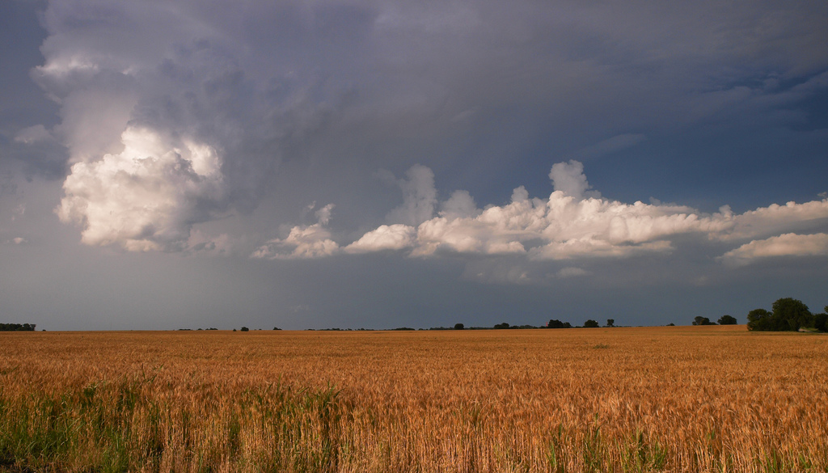

OSHA Consultation Services
Safety Pays®
in the
Grain Handling Industry

Slide 2
Safety Pays® OSHA Consultation
  What is “Safety Pays®”?
    On site safety and health consultation services provided by the Oklahoma Department of Labor
What services does it include
  Full service
  Limited service
    Safety
    Health
How much does it cost?
  The Oklahoma Department of Labor does not charge employers a service. We are funded through a grant from Federal OSHA.
  In short, it’s FREE!

Slide 3
Safety Pays® OSHA Consultation
What is the employers obligation?
  The employer is required to correct any serious hazards or imminent dangers in a timely manner.
  Serious hazards must typically be corrected within 30 days.
What kind of training do the consultants have?
  Our Consultants attend training at the OSHA Training Institute along side OSHA compliance officers.

Slide 4
Safety Pays® OSHA Consultation
How is a visit conducted?
  Opening conference
  Review of injury and illness records
  Review of written safety and/or health programs
  Walkthrough of the facility to identify hazards
  Closing Conference
  Written report

Slide 5
Safety Pays® OSHA Consultation
Who typically participates in the visit?
  Management
  Supervisors
  Employees

Slide 6
How Long Does It Take?
This isn’t an easy answer. Many factors come into play:
  Size of the facility
  Complexity of access
  Complexity and size of written programs and injury and illness records
  Number of staff involved
  Type of visit

Slide 7
Safety Pays® OSHA Consultation
Will a consultation lead to a Federal OSHA inspection?
  All information is kept confidential.
  The only time Federal OSHA is contacted is on the rare occasion a company refuses to correct serious hazards within a reasonable period of time, but only after the ODOL has made every attempt to work with the company to eliminate the hazard

Slide 8
Safety Pays® OSHA Consultation
Special programs also offered:
  $1,000 tax exemption for a full service safety and/or health consultation
  SHARP – safety & health achievement recognition program – designed to recognize “the best of the best”
  WCPR – workers’ compensation premium reduction program – help for those with an experience modifier of 1.0 or greater tied to their worker’s compensation insurance policy.
  Looking SHARP Newsletter – accessible at our website www.labor.ok.gov

Slide 9
Safety Pays® OSHA Consultation
Federal OSHA has conducted an inspection at our facility but we want to work with Consultation. How soon can you come out?
  Once a Federal OSHA inspection is initiated, On-Site Consultation cannot enter the facility until Federal OSHA has completed it’s inspection and issued a Final Order.
  You can make your request prior to the issuance of the Final Order, however, your consultants cannot come out until the Federal OSHA case is closed.

Slide 10
Safety Pays® OSHA Consultation
How do I get started?
  We can’t come out unless we are invited.
  The employer or their designated representative must request the visit.
  Requests can be made
    by phone or
    through our website
  Consultants generally maintain a backlog of visits, which may vary. Your consultant(s) call you to schedule a time that is good for you.

Slide 11
For more information:
Betsey Kulakowski, CSHO
Safety Consultant
Oklahoma Department of Labor
3017 N. Stiles, Suite 100
Oklahoma City, OK 73105
(405) 521-6145
Betsey.kulakowski@labor.ok.gov
www.labor.ok.gov

