Slide 1
National Grain and Feed Association
Oklahoma Grain and Feed Association
Texas Grain and Feed Association
Are You Prepared for a Visit From OSHA
Seminar
Update on Emerging and Evolving Regulatory Issues – OSHA
January 6, 2011
Oklahoma City, OK
Jess McCluer
National Grain and Feed Association

Slide 2
Top OSHA Issues Affecting Grain Handling and Processing Facilities
  Sweep Auger Letter of Interpretation
  OSHA Enforcement Policy and Penalties
    Letter to Industry on Grain Bin-Entry Procedures
Notes:
The purpose of the presentation is to give you an update on some current OSHA issues, including the sweep auger letter of interpretation and the Agency’s current enforcement and penalty policies.

Slide 3
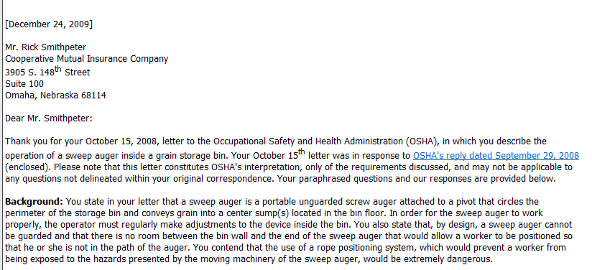
OSHA Sweep Auger Letter of Interpretation

Slide 4
OSHA Sweep Auger
Letter of Interpretation
On 12/24/09 OSHA issued a letter pertaining to sweep auger operations within grain bins: www.osha.gov (Interpretations)
  Prohibits an employee from working inside a bin while an unguarded sweep auger is in operation
  OSHA offered no acceptable procedures that would allow a person to work inside a bin when an unguarded auger is in operation
Notes:
4
The Occupational Safety and Health Administration (OSHA) on Dec. 24 signed a “letter of interpretation” that creates a new policy for operating sweep augers inside grain bins. The letter was in response to questions posed by an insurance representative, who had asked: 1) if a sweep auger can be operated in a bin with an employee present; and 2) if not, what method or procedure OSHA would find acceptable for removing grain from flat-bottom grain bins.
Other than a provision in the OSHA grain handling safety standard (1910.272) that addresses whether an employee may enter a bin when machines are operating, OSHA does not have a formal policy addressing the operation of sweep augers.
In its response letter, OSHA stated that an employee cannot work inside a bin while an unguarded sweep auger is in operation. Further, the agency did not offer any other type of procedure to remove grain from a bin if an unguarded auger cannot be used.
After obtaining a copy of OSHA’s letter of interpretation, the NGFA learned that the agency’s Directorate of Enforcement Programs supported many of the recommendations that NGFA and GEAPS made during the August meeting and included them in the first draft of the response letter. However, based upon recent incidents in grain-handling facilities involving falls and engulfments that have resulted in fatalities, the OSHA solicitor’s office changed the agency’s response, banning employees from working inside bins while unguarded sweep augers are operating.

Slide 5
What Does the Letter Mean?
Until / unless modified, the “letter of the law” and supersedes previous documents.
Each Region, Area Office and State Plan State can and has been interpreting the letter differently.
  OSHA has used this letter to issue citations in 2010.
NGFA has met with OSHA in October and continues to work with OSHA to review the December 24th letter and it’s impact on grain handling and processing.
  Anticipate written communication from OSHA regarding this situation early in 2011.
Notes:
5
5
The current uncertainty on what type of sweep-auger equipment can be used and the types of procedures OSHA may find acceptable have caused great concern within the NGFA and its membership.
Further, citations have been issued by a Regional Office and State Plan States for employees operating in bins with improperly guarded equipment e.g. only the top and back of auger covered not deenergized, prior to the letter being publicly available on the OSHA Web page.
5

Slide 6
Sweep Auger Timeline
September 30, 1996 – Following the promulgation of the Grain Handling Standard’s technical amendment, OSHA issued an internal memorandum with an interpretation of 1910.272 (g) (1) (ii).
January 23, 2008 – Insurance representative sends letter to OSHA with questions about employees working in bins with operating equipment.
September 29, 2008 – OSHA issued a response letter titled, “Grain handlers and engulfment hazards; procedures for unguarded sweep augers.[1910.23(a)(5); 1910.272; 1910.272(e)(2); 1910.272(g)(1)(ii); 1910.272(g)(2)] , “ the Agency states “the standard (1910.272(g)(1)(ii)) is not intended to be prohibition against employees entering grain storage structures while machinery is running.” OSHA does not recognize 1996 memorandum.
October 15, 2008 – Insurance representative sends second letter to OSHA asking “Can an unguarded sweep auger be in operation (energized) in a grain bin while an employee is inside the bin?” Does not specifically identify what is meant by guarded or unguarded.
Notes:
Sep. 30 – The memo stated that the provision was not intended to be a prohibition of employees entering a grain storage structure while machinery is running as long as the employer can demonstrate that appropriate protection has been provided to prevent employees from being exposed to the hazards/danger of the moving machinery.
January 23, 2008 – I have heard that the representative was acting on behalf of a client who made modifications to an auger and wanted to get approval from OSHA. They originally went to the Omaha office who told them “No, we can’t help you” and then to the OSHA National Office. They did not contact NGFA or GEAPS.

Slide 7
Sweep Auger Timeline (cont.)
January 2009 – Industry is made aware of letter after it is posted on OSHA public Web page.
August 2009 – Representatives from NGFA and Grain Elevator and Processing Society meet with OSHA to discuss the sweep auger issue.
December 24, 2009 – OSHA issued a letter to insurance representative stating that it is a violation of 1910.272 (g) (1) (ii) unless the employer can eliminate all hazards presented by an energized unguarded sweep auger. (Yet to be posted on OSHA public Web page).
Notes:
In August 2009, representatives from the NGFA and Grain Elevator and Processing Society (GEAPS) met with OSHA officials to discuss the methods and procedures used for the operation of sweep augers inside grain bins. The meeting was based upon OSHA’s request to learn more about the process of removing grain from a bin as it developed a response to the letter received from the insurance company representative, not associated with the NGFA, who had asked the agency to explain its “policies and procedures” for operating a sweep auger.
OSHA agreed to meet with the NGFA and GEAPS to discuss how sweep augers operate, how they are used within the grain handling industry and how the initial best practices document was developed prior to issuing a response to the insurance representative’s second letter. Representatives of three OSHA entities were involved in the meeting – the Directorate of Standards and Guidance, the Directorate of Enforcement Programs and the Solicitor’s Office. During the meeting, several means of addressing employee safety while operating a sweep auger were discussed, including: 1) job safety analysis; 2) lockout/tagout of equipment; 3) confined space entry permits; 4) machine guarding; and 5) providing space between auger and employee while the auger is in use. The NGFA and GEAPS also emphasized that in the preamble of the grain handling standard, OSHA based the final language for Section 1910.272(g)(1)(ii) on comments that more flexibility is needed to protect employees from equipment when working inside bins, silos or tanks.

Slide 8
Sweep Auger Timeline (cont.)
February 22, 2010 – NGFA submits letter to OSHA asking them to rescind December 24, 2009 letter and asks to schedule meeting to further discuss issue.
April 2010 – OSHA declines to meet with NGFA unless they identify specific parts of the December 24 the letter to discuss.
May 4, 2010 – NGFA submits letter to OSHA that points to several conflicts between OSHA’s statements in the Dec. 24th letter compared to its current standards. The NGFA also cited how previous correspondence between the agency and the NGFA regarding deenergization was not referenced in the Dec. 24 OSHA letter.

Slide 9
Sweep Auger Timeline (cont.)
October 7, 2010 – Members of the NGFA Safety, Health and Environmental Quality Committee meet with senior OSHA staff to discuss the issues raised in the May 4 letter and to provide and economic analysis of the letter’s current and future impact on industry.

Slide 10
What Should I Do?
Have effective safety and health program and procedures.
Review and analyze December 24th letter of interpretation and make changes to sweep auger operation process as you interpret.
Be prepared to explain to OSHA why you have or have not made changes to current policy.
Look for alternatives
  “No entry” sweeps
  Effective Lockout Tagout system
  Cyclone vacuum systems
  Air augers
Notes:
10
10
10

Slide 11
Next Steps
NGFA is waiting for response from OSHA, following meeting with senior leadership, and results of citation challenges to determine next legal and/or political actions.
Notes:
In addition, we have learned that a Senator has forwarded a letter from a constituent to OSHA that asks for clarification on the Dec. 24, 2009 sweep auger letter of interpretation. Most likely the response that the Senator receives will be very similar to the one that NGFA receives.

Slide 12
OSHA Enforcement
Federal and State OSHA Inspections
Facts, Figures, Trends at Grain Elevators and Feed Mills
Most Commonly Cited Standards

Slide 13
FY 2006–FY 2010
Inspections Conducted
50,000
38,579
39,324
38,450
39,004
40,000
35,973
30,000
20,000
10,000
0
FY06
FY07
FY08
FY09
*
FY10
*as of September 3, 2010

Slide 14
FY 2006–FY 2010
Total Violations Issued
100,000
87,663
87,898
86,945
84,323
82,804
75,000
50,000
25,000
0
FY06
FY07
FY08
FY09
*
FY10
*as of September 3, 2010

Slide 15
FY 2006–FY 2010
Percent of Total Violations Issued as Serious
100%
76%
77%
77%
78%
80%
73%
60%
40%
20%
0%
FY06
FY07
FY08
FY09
FY10

Slide 16
FY 2006–FY 2010
Percent of Total Violations Issued As Serious, Willful, and Repeat
100%
81%
81%
83%
77%
79%
80%
60%
40%
20%
0%
FY06
FY07
FY08
FY09
FY10

Slide 17
FY 1990 – FY 2010 (Oct 1 – Sept 3)
Significant Enforcement Cases
250
Projected EOY - 167
200
199
195
165
170
150
150
140
154
127
120
123
121
120
103
107
101
108
100
61
69
50
57
27
27
0
FY90
FY91
FY92
FY93
FY94
FY95
FY96
FY97
FY98
FY99
FY00
FY01
FY02
FY03
FY04
FY05
FY06
FY07
FY08
FY09
FY10

Slide 18
FY 1990 – FY 2010(Oct 1 – Sept 3)
Egregious Cases
25
Projected EOY 20
20
17
18
16
18
15
15
11
10
8
8
6
6
6
6
5
5
5
4
5
3
3
4
2
2
0
FY90
FY91
FY92
FY93
FY94
FY95
FY96
FY97
FY98
FY99
FY00
FY01
FY02
FY03
FY04
FY05
FY06
FY07
FY08
FY 09
FY10

Slide 19
OSHA 2010 Inspections
1/1/2010 to 10/31/2010
Country Grain Elevators [SIC 4221 – Farm Product Warehousing & Storage]
  32 inspections, 101 citations, initial penalties of $137,300
Feed Manufacturing Industry [SIC 2048- Prepared Feed & Feed Ingredients – except Dog & Cat]
  58 inspections, 217 citations, initial penalties of $385,207
Terminal Elevators [SIC 5153 - Grain and Field Bean Wholesalers]
  77 inspections, 238 citations, initial penalties of $1,455,425
Totals, 167 inspections / 556 citations / $1,978,031

Slide 20
Top Citations, SIC 4221
1/1/2010 to 10/31/2010 – OSHA Database
Citation | Number | Initial Penalty
Grain Handling Std. (B/T/S 15, Housekeeping 4) | 26 | $17,725
Guarding Floor & Wall Openings | 14 | $18,500
Electrical Wiring | 12 | $11,600
Mechanical Power Trans | 12 | $10,725
Confined Space Entry | 6 | $4,500
Machine Guards (general requirements) | 4 | $14,825
Records/Reporting | 4 | $5,000
Notes:
20

Slide 21
Top Citations, SIC 2048
1/1/2010 to 10/31/2010 – OSHA Database
Citation | Number | Initial Penalty
Mechanical Power Trans | 27 | $25,120
Lockout / Tagout | 26 | $68,531
Grain Handling Std. | 24 | $23,225
Guarding Floor & Wall Openings | 20 | $27,375
Electrical Wiring | 15 | $19,950
Confined Spaces | 14 | $33,725
Electrical Gen. (marking) | 14 | $24,285
Records/Reporting | 7 | $4,000
(Housekeeping 8, B/T/S 6)
Notes:
21
21

Slide 22
Top Citations, SIC 5153
1/1/2010 to 10/31/2010 – OSHA Database
Citation | Number | Initial Penalty
Grain Handling Std. (B/T/S 52, HSK 15, Training 14) | 113 (13W) | $826,625
Confined Space Entry | 48 (7W) | $414,825
Mechanical Power-Trans | 22 | $16,100
Guarding Floor & Wall Openings | 20 | $26,325
Respiratory Protection | 16 | $14,875
Electrical Wiring | 11 | $9,450
Hazard Communications | 11 | $2,050
Records/Reporting | 7 | $11,050
Notes:
22
22

Slide 23
Announced Emphasis Programs
National Emphasis Programs
  Amputations and Fall Hazards
State Wide Programs
  Arkansas, Colorado, Illinois, Kansas, Louisiana, Montana, North Dakota, Ohio, Oklahoma, South Dakota, Texas and Wisconsin
Area offices with emphasis programs
  Kansas City, St. Louis, Omaha, Wichita
Indiana OSHA and Minnesota OSHA have state-run emphasis

Slide 24
Region V REP Announcement
The areas OSHA mentions in the REP are:
  • Falls
  • Electrocution
  • Grain engulfment
  • Auger entanglement
  • Struck by
  • Combustible Dust
OSHA states “All inspections under this REP must address all aspects of any potential grain handling work and include a review of all related written documentation (i.e., lock-out/tag-out program, forklift operation, grain entry program and procedures, housekeeping programs, fall protection program, personnel protective equipment, confined space entry, machine guarding, and safety related work practices).”
Notes:
Issues raised in the Region V REP are very similar to the ones raised in the Region VI REP that Jorge discussed earlier this morning. (Get copy of Region VI letter.

Slide 25
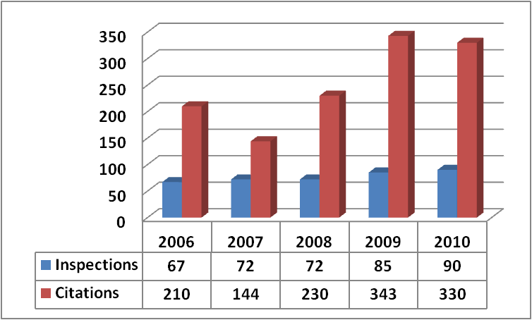
OSHA Inspections/Citations –
Grain Elevators (SIC 5153)

Slide 26
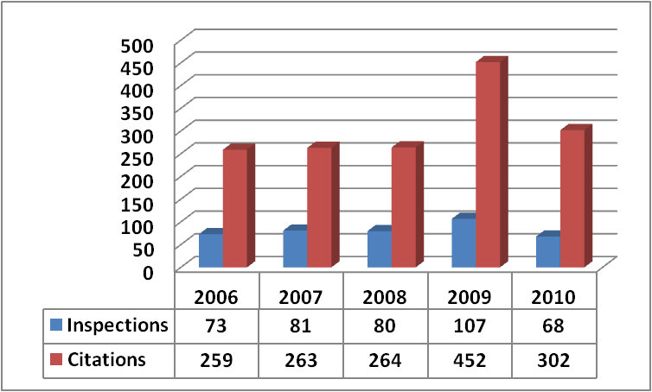
OSHA Inspections/Citations –
Feed Mills (SIC 2048)

Slide 27
OSHA Penalties –
Grain Elevators

Slide 28
OSHA Penalties –
Feed Mills

Slide 29
Federal Versus State
OSHA Activity - Past 12 Months
21 approved State Plans (private sector)
 | Grain Elevators
 | Federal | State
Inspections | 74 | 16
Citations | 312 | 18
Penalties | $2,993,121 | $79,960
Feed Mills
Federal | State
32 | 36
174 | 128
$519,155 | $88,970

Slide 30
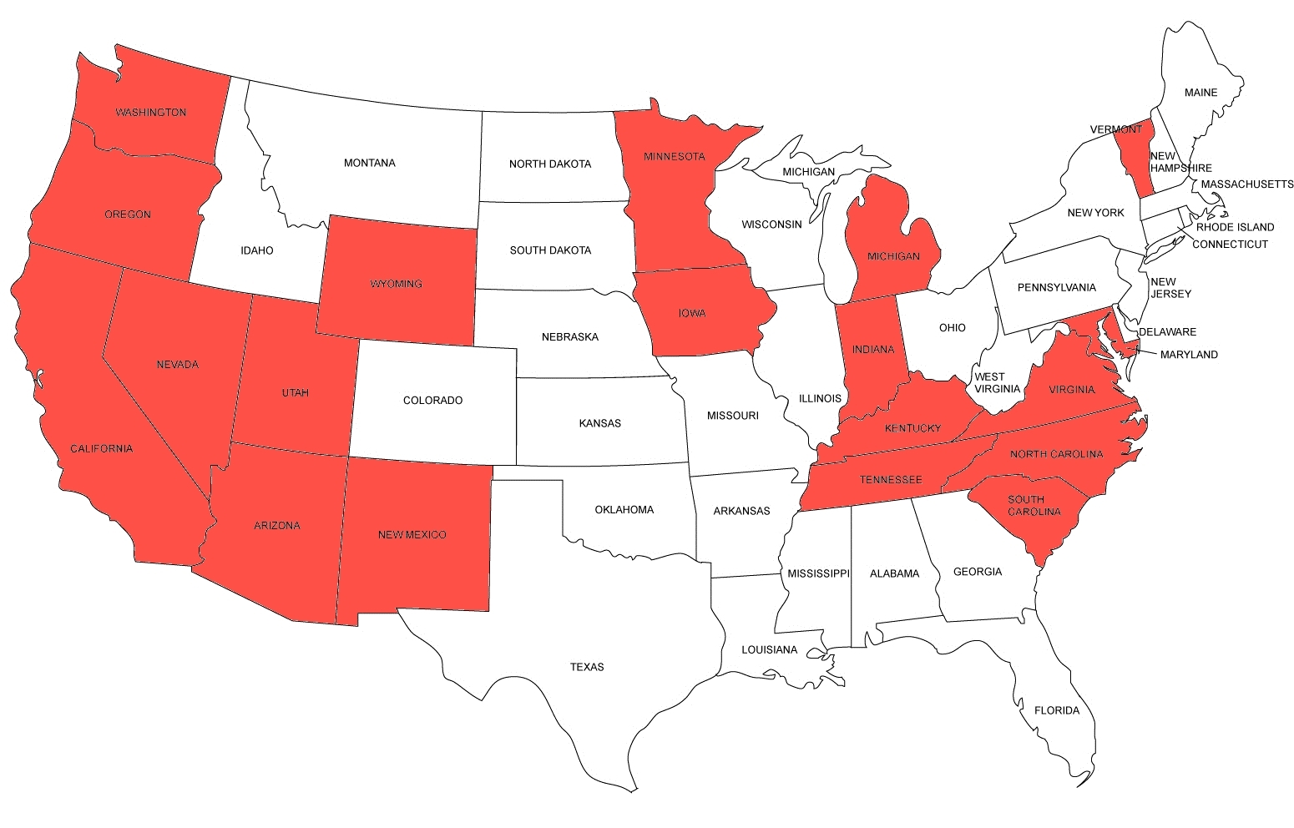

Slide 31
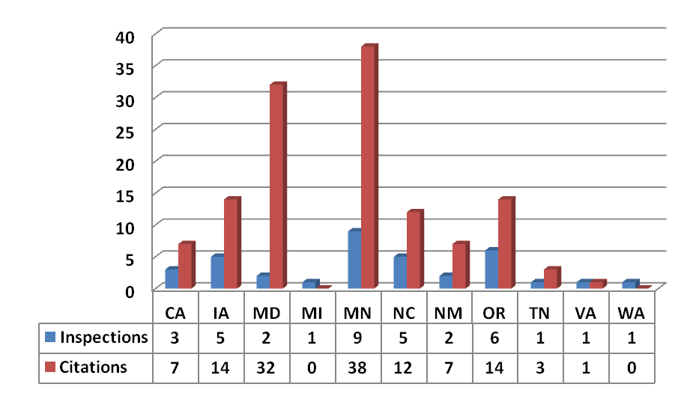
State OSHA Inspections/Citations at
Feed Mills - Past 12 Months

Slide 32
What to Expect in FY 2011 and Beyond
General Enforcement Overview

Slide 33
Citation and Enforcement:
FY 2010 Enforcement Overview
33
In September 2010, Deputy Assistant Secretary Richard Fairfax confirmed that OSHA is on track to exceed enforcement performance on a wide range of measures in FY 2010 as compared to prior years
OSHA has already performed 35,973 inspections (as of September 3, 2010), on target to exceed the 39,004 inspections conducted in FY 2009
OSHA has already issued 154 significant enforcement citations (more than $100,000 in penalties) and is on track to issue 167 significant enforcement citations for FY 2010
OSHA has already issued 18 egregious cases (instance-by-instance violations) and is projected to issue 20 before the end of FY 2010 (as compared to four egregious cases for FY 2009)

Slide 34
The New OSHA:
An Overview
Old OSHA | New OSHA
Stable budgets. | Increased funding for CSHOs and attorneys in the Solicitor’s Office.
Focus on corporatewide issues and worst offenders. | Significantly increased attention to worst offenders and corporate wide issues.
Focus on nonregulatory methods to improve worker safety such as guidance documents, SHIBs, etc. | Standard setting is a top priority, including numerous health standards and other controversial areas such as safety and health programs.
Scale back on recordkeeping requirements. | Enhance recordkeeping and use enforcement tools to ensure accuracy of data.
Predictable penalties. | Higher penalties across the board; greater emphasis on criminal prosecutions.
Notes:
These slides provide an example of the differences between the priorities of OSHA in the previous Administration and the current Administration. As President Reagan once said, “Personnel is Policy.” The senior staff of OSHA in the current Administration, including the Administrator, Chief of Staff and the Deputy Adminstrators primarily have a background in academia and unions…not industry.

Slide 35
The New OSHA:
An Overview
Old OSHA | New OSHA
Reported injuries at a record low because of OSHA’s efforts. | Reported injuries at a record low because of widespread under-reporting.
Expanded on compliance assistance and cooperative programs to bring down fatality, injury, and illness rates. | Cooperative programs curtailed in favor of more resources focused on enforcement and citation programs.
Limited use of General Duty Clause citations for ergonomics, workplace violence. | Increased use of General Duty Clause for ergonomics, workplace violence, and numerous other areas.
Willingness to settle cases with citations “unclassified.” | Limited use of “unclassified” citations as a settlement tool.
Enhanced Enforcement Program (EEP). | Severe Violators Enforcement Program (SVEP).

Slide 36
Citation and Enforcement:
General Duty Clause Enforcement
Section 5(a)(1) of the OSH Act states: “Each employer shall furnish to each of his employees employment and a place of employment which are free from recognized hazards that are causing or are likely to cause death or serious physical harm to his employees.”
  Currently used to cite employers for ergonomic injuries, combustible dust, and other OSHA-identified hazards for which the agency currently has no standards.
  Citation issued in 2009 to retailer for Black Friday stampede that killed worker.
  H1N1 Influenza Enforcement Procedure
Dr. Michaels has made clear his preference to expand the use of the General Duty Clause:
  “OSHA has abandoned the General Duty Clause. It is time for the agency to start using it again.” Dr. Michaels, 2007
  “OSHA doesn’t need a new standard if a hazard is serious and there are recognized measures to mitigate the hazard.” Dr. Michaels, 2007
  "The General Duty Clause serves an important purpose because it is impossible for OSHA to create a standard for every hazard, as in the cases of ergonomics, workplace violence, specific chemical or bacterial exposure, or structural strength.“ Dr. Michaels at the September 2010 OSHRC Judicial Conference

Slide 37
Citation and Enforcement:
Repeat Violations
Currently, to establish a repeat violation under section 17(a) of the OSH Act, OSHA must prove that:
  The cited employer is the same one that was cited previously;
  The previously cited employer was cited at least once before (and within three years of the time that the previous violation became a final order);
  The earlier citation became a final order of the Occupational Safety and Health Review Commission; and
  The earlier citation was for a substantially similar violation.
Repeat citations are very costly to employers—up to five times the penalty of the first-offense citation.
  Three repeat citations (or Three Willful and repeat violations in combination) will place the employer in the Severe Violators Enforcement Program (SVEP).
Anticipate a broadening of OSHA’s willingness and ability to cite repeat violations:
  Broadening the scope of what is defined as a “repeat” offense under section 17(a).
  Citations for a single employer across multiple facilities may support “repeat” finding.

Slide 38
Citation and Enforcement:
SVEP Program
OSHA’s Enhanced Enforcement Program (EEP) was created to focus resources on “those employers who are indifferent to their obligations under the OSH Act.”
  But in April 2009 congressional hearings, OSHA agreed that the EEP was not working as intended and needed to be improved to target “truly bad actors,” such as those with willful or repeat violations and/or those linked to workplace fatalities.
Severe Violators Enforcement Program (SVEP) designed by an OSHA Task Force to replace the EEP.
  OSHA finalized the SVEP directive on April 22, 2010 and it went into effect on June 18, 2010.
38
38
Notes:
How many of you are familiar with the SVEP Program?

Slide 39
Citation and Enforcement:
SVEP Program
OSHA will consider any inspection that meets one or more of the following criteria as a candidate for the SVEP:
  Fatality/Catastrophic Criteria. A fatality/catastrophe inspection in which OSHA finds one or more willful or repeated citations or failure to abate notices based on a serious violation related to the death of an employee or three or more hospitalizations. Violations under this section do not need to be classified as “High Emphasis Hazards.”
  Nonfatality/Noncatastrophic High Emphasis Hazards. An inspection that finds two or more willful or repeated violations or failure to abate notices based on high-gravity, serious violations due to a High Emphasis Hazard.
  A “High Emphasis Hazard” is one based on a fall or a specific NEP identified in the draft, and thus includes (1) fall hazards under general industry, construction, shipyard, marine terminal, and longshoring standards; (2) amputation hazards; (3) combustible dust hazards; (4) crystalline silica hazards; (5) lead hazards (based on sampling); (6) excavation and trenching hazards; and (7) ship-breaking hazards.
  Nonfatality/NonCatastrophic Hazards Due to the Potential Release of a Highly Hazardous Chemical –PSM. An inspection that finds three or more willful or repeated violations or failure to abate notices based on high-gravity, serious violations related to petroleum refinery hazards, i.e., hazards covered by the petroleum refinery PSM NEP and hazards associated with the potential release of highly hazardous chemicals, as defined by the PSM Covered Chemical Facilities NEP.
  Egregious Violations. All “egregious” enforcement actions (cases where OSHA has alleged instance-by-instance violation of a particular standard) will be considered SVEP cases.
39
39
Notes:
I don’t want to go into too much detail about the program due to time constraints, I just want to make you aware of it. You can get further information from the OSHA Web page and from the slides once they’re posted on the NGFA, OK Grain and Feed and the TX Grain and Feed Web sites.

Slide 40
Citation and Enforcement:
Consequences of Placement into SVEP Program
Enhanced, Broad Follow-up Inspections.
  Follow-up inspections of the cited workplace will be conducted after the citation becomes a final order, even if abatement verification has been received.
  In other words, these follow-up inspections are not limited in scope to whether the identified hazard has been abated, but will also include an assessment of whether the employer is engaging in similar violations.
  For Construction Industry worksites that close before a follow-up investigation can be conducted, at least one of the employer’s other worksites will be inspected.

Slide 41
Citation and Enforcement:
Consequences of Placement into SVEP Program
Nationwide Inspections.
  Where the agency has reason to believe that a citation is part of a broader pattern of noncompliance, OSHA will conduct inspections at related worksites of that employer. This means, for example, that a Pennsylvania facility that is cited for a particular violation can trigger an investigation of a Texas-based worksite of that same employer.
  According to the SVEP, the scope of the related inspection “will depend upon the evidence gathered in the original SVEP inspection.”
  Specifically, OSHA will be looking for evidence of broader noncompliance patterns in its initial investigations—and may issue document requests or subpoenas to gather evidence to determine whether related investigations are warranted.
  OSHA also will identify potential locations to state plan states, and will accept referrals from state plan states.

Slide 42
Citation and Enforcement:
Consequences of Placement into SVEP Program
When the regional administrator determines that related worksite inspections for the employer should be conducted, the following rules apply:
  For General Industry worksites with three or fewer similar or related worksites nationwide—all worksites will be investigated.
  For General Industry worksites with four or more similar or related worksites nationwide—the Director of the Directorate of Enforcement Programs (DEP) shall issue an SVEP nationwide inspection list with respect to the employer. Normally, where there are 10 or fewer similar or related worksites, all will be inspected. When there are more than 10 such establishments, random numbers will be assigned to the worksites on the list and the first 10 will be inspected. The Director of DEP has discretion to select particular establishments for inspection and to conduct further investigations as deemed necessary.
  For nationwide inspections that involve PSM hazards, inspections will be limited to the willful or repeated citations or failure to abate notices that were issued and will not include worksites that were inspected during the previous two years.
  For Construction Industry worksites that operate in different regions, where deemed necessary, the Director of DEP will issue an SVEP nationwide referral. The procedures outlined above with respect to General Industry worksites will apply.

Slide 43
Citation and Enforcement:
Consequences of Placement into SVEP Program
Enhanced Settlement Provisions. OSHA will press SVEP participants to accept the following in settlement negotiations:
  hiring an independent safety consultant to work through compliance issues;
  applying settlement agreements companywide in accordance with OSHA’s 1991 Guidelines for Administration of Corporate-Wide Settlement Agreements;
  imposing interim abatement controls where full abatement may take time;
  imposing weekly or other enhanced reporting measures to report current or future jobsites for a certain time period;
  requiring employers to report work-related injuries and illnesses on a quarterly basis and consent to inspections based on that data; and
  requiring employers to report for a specified time period any serious injury or illness requiring medical attention, and to consent to inspections based on that data.

Slide 44
Citation and Enforcement:
Consequences of Placement into SVEP Program
Increased Awareness of OSHA Enforcement.
  The agency will pursue higher-profile enforcement, ensuring, for example, that company headquarters are notified of site-specific issues. OSHA will also issue press releases upon the issuance of citations.
Enforcement Under Section 11(b).
  OSHA will strongly consider SVEP cases for federal court enforcement orders under Section 11(b) of the OSH Act.

Slide 45
Citation and Enforcement:
SVEP Program—Unanswered Questions
Unanswered Questions and Implications
  It is not clear how an employer will be removed from the program.
    Will an employer be released from the SVEP if OSHA conducts a follow-up inspection of the originally cited worksite and does not find any similar level of violations? Or is there something more an employer would need to do, such as comply with some or all of the enhanced settlement provisions described above?
  It is not clear whether OSHA will face challenges from employers for probable cause if the agency attempts to conduct inspections of other worksites based upon a citation satisfying one of the criteria set forth in the directive, even though the citation is not yet a final order of the OSHRC.
    Under well-developed caselaw, OSHA is required to target its enforcement based upon neutral criteria, and the SVEP’s targeting system, currently based upon unadjudicated citations, potentially creates a number of constitutional and legal issues for the agency.
  It is unclear how the contest rate of OSHA citations will be impacted if the agency closes the door to potential settlements of willful violations and other citations using the Section 17 “unclassified” approach.

Slide 46
Citation and Enforcement:
Penalty Enhancement
On April 22, 2010, OSHA announced it would revise OSHA penalties as calculated in the agency's Field Operations Manual (FOM).
Dr. Michaels signed the memorandum titled "Administrative Enhancements to OSHA's Penalty Policies“ to OSHA Regional Administrators. In the memorandum, Dr. Michaels stated that OSHA's "penalties are too low to have an adequate deterrent effect."
The changes include:
  Lengthening the time frame for considering an employer's history of serious, willful, repeat, or failure to abate violations from three to five years.
  Lowering the reduction levels provided to employers based on size, e.g., no size reduction will be allowed for employers with more than 251 workers, according to the memo.
  Any employer who has been cited for any high-gravity serious, willful, repeat, or failure to abate violation within the last five years will receive a 10% increase on the current citation (conversely, if no violations during that period, employer will receive a 10% reduction).

Slide 47
Citation and Enforcement:
Penalty Enhancement
  Minimum penalties for serious violations will be increased to $500.00.
  Reduction of OSHA area directors' discretion for potential penalty reductions they can offer without obtaining approval from OSHA regional office.
  The 10% reduction for employers participating in a strategic partnership will be eliminated.
  Raising the way in which final penalties are calculated by applying final penalties serially, starting with the gravity-based penalty and deducting the history, good-faith, size, and quick-fix reductions in turn.
  Raising gravity-based penalties from a range of $1,500 to $7,000 to a range of $3,000 to $7,000.
Dr. Michaels stated in the OSHA press release announcing these changes: "OSHA inspections and penalties must be large enough to discourage employers from cutting corners or underfunding safety programs to save a few dollars."

Slide 48
Citation and Enforcement:
Penalty Enhancement
OSHA has delayed implementation of this penalty enhancement policy although OSHA leadership has recently made statements that the agency plans to move forward with this policy in October 2010. OSHA Deputy Assistant Secretary Jordan Barab made a statement on September 14, 2010 that OSHA will launch these new higher penalties in October, and that OSHA "is back to its original function of enforcing law and order."
OSHA state plan states have objected to OSHA's plan to move forward with these new increased civil penalties. In a letter addressed to David Michaels dated August 6, 2010, the board of the Occupational Safety and Health State Plan Association (OSHSPA) stated:
  They have "very serious concerns about this unilateral decision to impose an enforcement procedure absent any statutory change to the OSH Act by Congress."
  OSHSPA criticized OSHA leadership for failing to consult with them on a number of policy decisions including the new requirement that all state plan states have to adopt all future NEP programs as well as the new mandatory penalty increases.
  OSHSPA noted it believes "there is a strong disconnect between OSHA's stated rationale for implementing new penalty procedures and the employers/employees likely to be impacted the most by this change. State Plan States' experience has shown that an effective method to achieve greater compliance among small employers is by focusing on education and training while increasing the likelihood of an onsite inspection" rather than higher penalties, which will disproportionately impact small businesses.
  OSHSPA stated that it believes that "OSHA's approach in developing the new penalty calculation procedures was misdirected from the beginning because it started with the premise that raising the average serious penalty significantly would provide a deterrent effect, instead of focusing on what changes to the penalty calculation procedures for serious violations would most likely result in the elimination or reduction of serious injuries, illnesses, fatalities.“
This new penalty policy is effective as of October 1, 2010 (OSHA announced on October 12, 2010)

Slide 49
OSHA Letter to Industry on Grain-Bin Entry Procedures

Slide 50
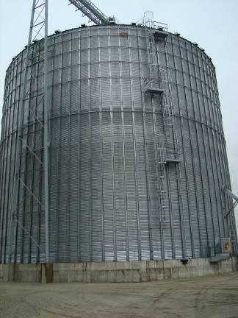
August 4th Speech,
Dr. David Michaels, Head of OSHA
“OSHA has investigated several cases involving worker entry into grain storage bins where we have found that the employer was aware of the hazards and of OSHA’s standards, but failed to train or protect the workers entering the bin,” wrote OSHA Administrator David Michaels.
Notes:
50
In the letter, the Agency states, “If an employee dies in a grain storage facility, in addition to any civil penalties proposed, OSHA will consider referring the incident to the US Department of Justice for criminal prosecution.”
Press conference with Dr. Michaels was held on the same day.
OSHA said researchers at Purdue University had documented 38 grain entrapment incidents in 2009 alone, but failed to indicate that 63 percent of
those (19) involved farm bins, while 37 percent (11) occurred in commercial grain operations and the location of the other eight cases was undetermined. Historically, nearly 70 percent of engulfment incidents have occurred in farm bins.
In addition, OSHA Chief of Staff Deborah Berkowitz, a former union official who was involved extensively in the AFLCIO’s efforts to develop the grain handling facility safety standard in the 1980s, contacted the NGFA and several media outlets expressing her personal “passion” for the engulfment issue.

Slide 51
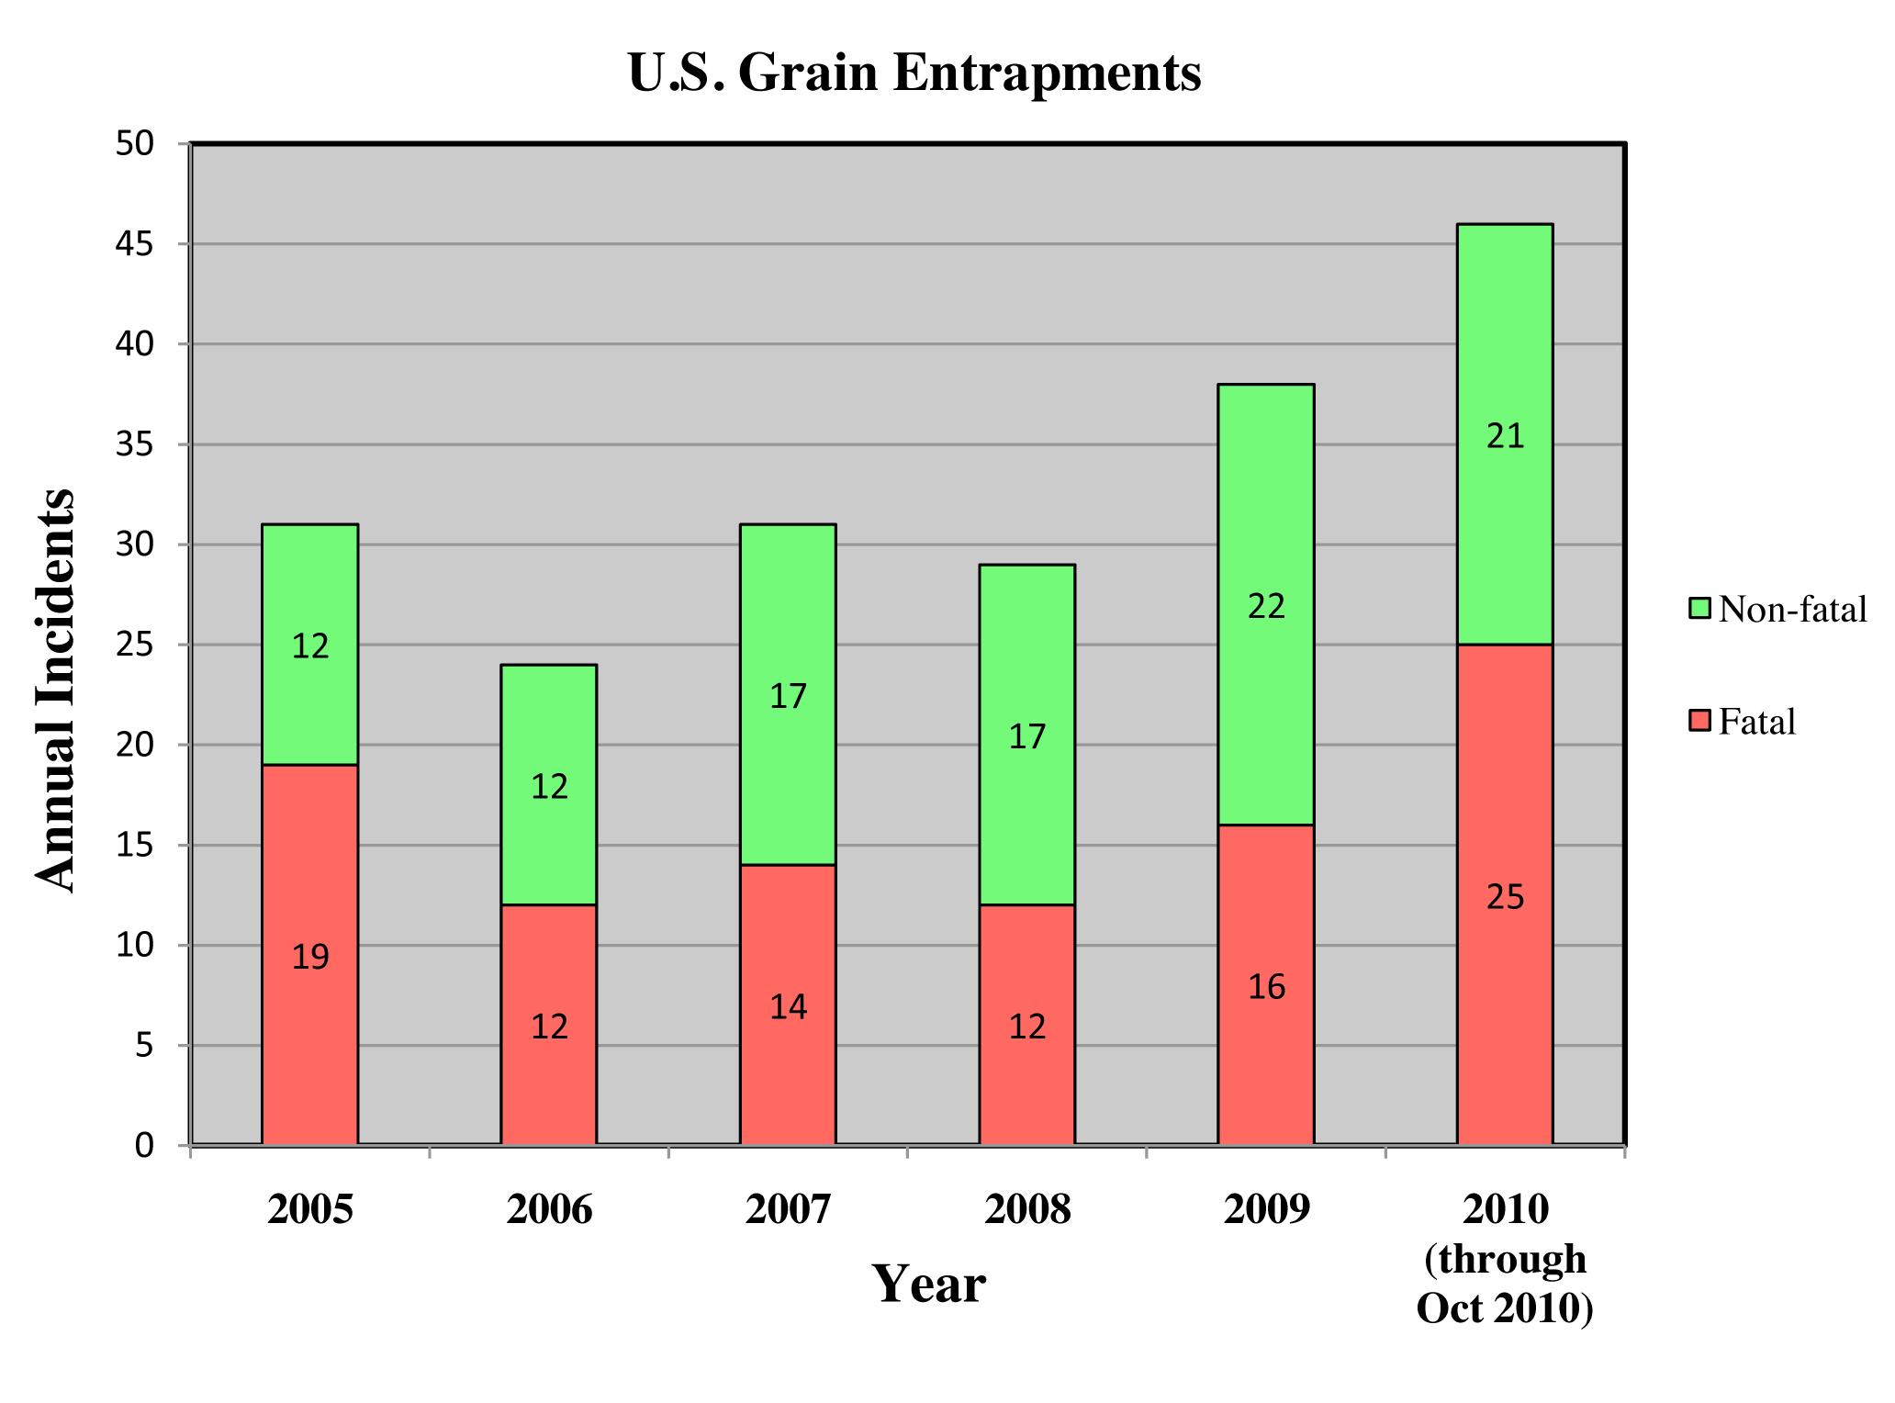
2010 Totals
70% on farm
30% commercial
At least 3
more in Nov.
Source: Purdue University Agricultural Safety and Health Program
Notes:
51
51

Slide 52
Deaths per Year
Commercial Sites due to Grain Entrapment
6.6 / year for 6 years 2004-2009
3.5 / year for 4 years 2000-2003
This exceeds the number of fatalities experienced from dust explosions during the 1960’s and 1970’s

Slide 53
August 4th Letter,
Dr. David Michaels, Head of OSHA
OSHA states they will consider referring all future cases that involve grain engulfment fatalities to the Department of Justice for criminal prosecution.
OSHA had initiated special emphasis programs examining safety practices at grain handling facilities.
http://www.osha.gov/asst-sec/Grain_letter.html
Notes:
53

Slide 54
Letter to Industry on Grain Bin-Entry Procedures (cont.)
In the letter, OSHA reminded employees of the grain handling standard’s regulations and governing bin entry procedures.
OSHA recently developed a new Grain Bin Entry Fact Sheet for employers and workers.
Notes:
1) Turn off and lock out all powered equipment associated with the bin, including augers used to help move grain; 2) prohibit employees from “walking down” grain and similar practices in an effort to make it flow; 3) provide employees entering bins with a body harness and lifeline, or
boatswain’s chair, and ensure it is secured prior to bin entry; 4) station an observer outside the bin or silo being entered, and ensure that the observer is equipped to provide assistance and contact others for help if needed; 5) prohibit workers from entering bins or silos underneath a grain-bridging condition or other situations in which a build-up of grain products on the sides could fall and bury them; 6) test the air within a bin or
silo prior to entry for the presence of combustible and toxic gases – if the manager has reason to believe such a condition may exist – to determine sufficient oxygen exists in the structure being entered; and 7) issue a permit for each binentry occurrence before an employee enters the structure, certifying that the required precautions have been taken.

Slide 55
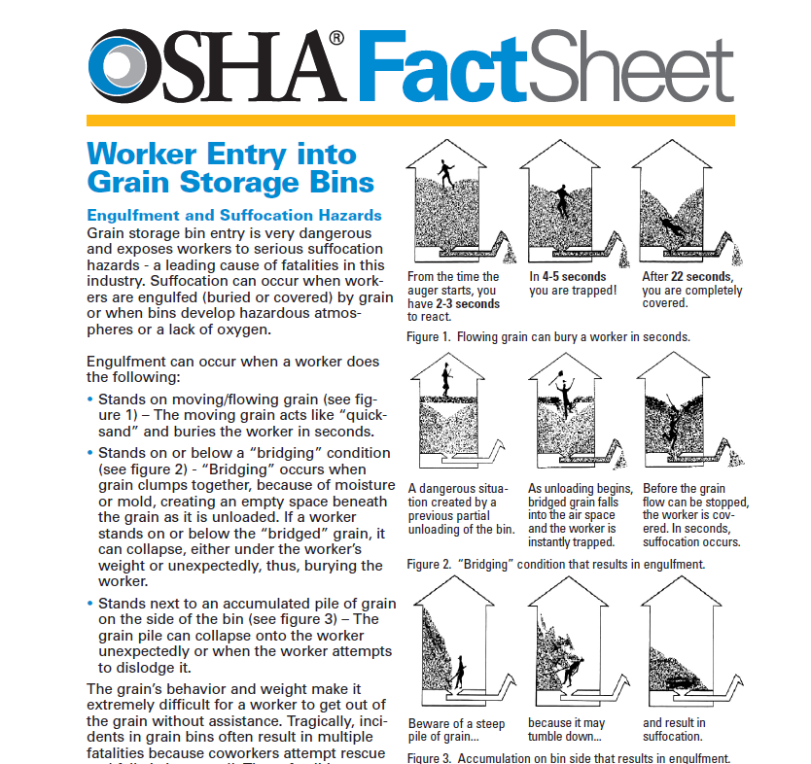
http://www.osha.gov/Publications/grainstorageFACTSHEET.pdf
Notes:
55
Members of the NGFA SHEQ Committee have reviewed and provided comments to OSHA on the SHIB. We are still waiting feedback from the Agency on our input.

Slide 56
October 15 Internal OSHA Letter
OSHA Assistant Secretary David Michaels sent an Oct. 15 letter to all OSHA personnel outlining the progress being made in transforming the way the agency addresses workplace hazards and communicates with employers and workers. In the letter, Dr. Michaels states “One area in which we are applying this new strategy, because we believe employers have not adequately protected workers, is entering grain storage bins.”

Slide 57
Recent OSHA Fines in Grain Industry
Involving Confined Space Entry
SD Wheat Growers Assoc. McLaughlin SD, $1.6 million (12/2009 fatality)
Tempel Grain, Haswell CO, $1.6 million (5/2009 fatality)
Cooperative Plus, Inc. Burlington, WI, $721,000, (2/2010 non-fatal engulfment)
Notes:
57

Slide 58
NGFA Bin-Entry Training Materials
NGFA and Purdue University produced Don’t Go With the Flow in 1998.
Program reviews hazards associated with flowing grain and most common types of entrapments at commercial facilities.
Provides information on effective procedures for rescuing partially and fully entrapped workers.
Training package includes 28 minute video, written lesson plan, pre- and post video test, warning poster and fact sheet.

Slide 59


NGFA/GEAPS
General Safety DVD
Newly created educational/training tool that addresses basic safety topics for new employees
  Approximately 35 minutes in length
  Available in Spanish
Includes DVD and CD with supplemental training materials
Notes:
Copies of the training programs and the order forms are available at the registration desk.
Project Description - Currently, neither NGFA nor GEAPS has a general safety video available to distribute to members. The proposed video will be based on GEAPS' Common Hazards/Common Sense video that was produced in 1988 after the OSHA Grain Industry Standard, 1910.272 was promulgated. It will provide new employees with an introduction to the major safety concerns for operations within a grain handling facility. The 30-minute video, which will also be translated into Spanish, will address the basics of the following topics:
Fire and Explosions
Confined Space and Bin Entry
Truck and Rail Safety e.g. fall protection
Safe Operation of Equipment e.g. lockout/tagout
Ladder Safety
Manlifts
Electrical
Personal Protective Equipment
Hazard Communication
First Aid
Emergency Action Plan
Facility Security

Slide 60
National Grain and Feed Association
Oklahoma Grain and Feed Association
Texas Grain and Feed Association
Are You Prepared for a Visit From OSHA Seminar?
Thank you!!
Jess McCluer
National Grain and Feed Association
202-289-0873
jmccluer@ngfa.org

